Slide 1

CISC 250 – Business Telecomm Networks
Internetworking and Routing

Slide 2
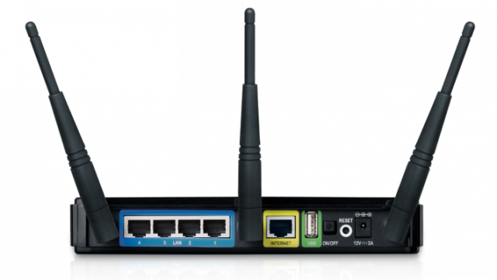
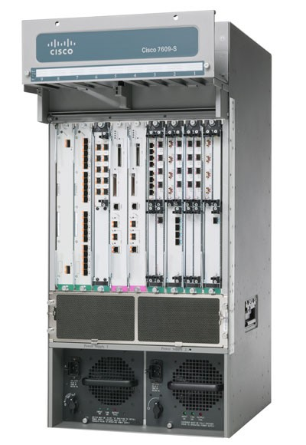
Router and Routing Decision
Router
A special device responsible for forwarding traffic among networks
Attached to different networks (subnets) using configurable interfaces (ports)
how does a router know where to send different packets?

Slide 3
Routing Decision
A Packet Arrives in a Port
Which Port Should the Router Send the Packet Back Out?
Destination Host
Router F
Routing
Table
Ethernet LAN
Incoming Packet
Router G
Router E
Telephone
Connection
Frame Relay Network
Token-Ring
LAN
Router H
Router I

Slide 4
Routing Decision
Destination Host May Be on One of the Attached Subnets. Router sends Packet to It
Destination Host
Router F
Routing
Table
Ethernet LAN
Router G
Router E
Telephone
System
Frame Relay Network
Token-Ring
LAN
Router H
Router I

Slide 5
Routing Decision
Destination Host
If destination host is not on a subnet, router must select BEST next-hop router (NHR)
Router F
Ethernet LAN
Routing
Table
?
Router G
Router E
?
Telephone
System
Frame Relay Network
?
Token-Ring
LAN
?
Router H
Router I

Slide 6
Routing Decision
A subnet may have multiple NHRs
Not enough to specify an interface; must also specify NHR
Router F
Routing
Table
Ethernet LAN
Router G
Router E
Telephone
System
Frame Relay Network
Token-Ring
LAN
Router H
Router I

Slide 7
Routing Table
Row
Network/
Subnet
Mask (/Prefix)*
Metric
(Cost)
Interface
Next-
Hop
Router
1
128.171.0.0
255.255.0.0 (/16)
47
2
G
2
172.30.33.0
255.255.255.0 (/24)
0
1
Local
3
192.168.6.0
255.255.255.0 (/24)
12
2
G
Each Row Represents a Route to a Network or Subnet
For Each Arriving Packet, The Packet’s Destination IP Address Is Matched Against the Network/Subnet Field in Each Row

Slide 8
Routing Table
Row
Network/
Subnet
Mask (/Prefix)*
Metric
(Cost)
Interface
Next-
Hop
Router
4
172.29.8.0
255.255.255.0 (/24)
34
1
F
The Interface is a port on the router
A subnet is attached to this interface
The subnet may have multiple hosts and next-hop routers
NHR column specifies a specific NHR on that subnet
For Row 4, send packet to subnet on interface 1, to NHR F

Slide 9
Routing Table
Row
Network/
Subnet
Mask (/Prefix)*
Metric
(Cost)
Interface
Next-
Hop
Router
2
172.30.33.0
255.255.255.0 (/24)
0
1
Local
If Next-Hop Router Field says Local,
Then the destination host is on the subnet attached to the interface (1)
Instead of sending the packet to a next-hop router on the subnet, the router will send the packet to its destination address

Slide 10
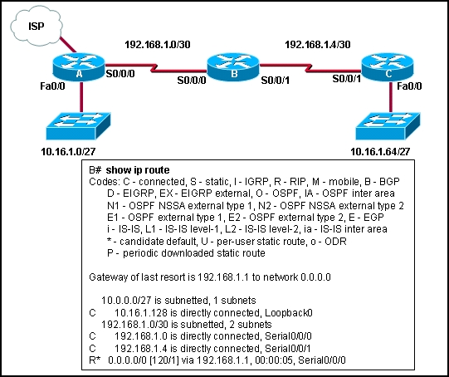
Routing Table Examples
Windows
cmd -> netstat –r (or “route print”)
Cisco

Slide 11
Routing Algorithm - Find Matching Rows
For Each Packet:
First, for each row in the routing table, find matches
Take destination IP address in packet
Mask it with the Mask in that row
Take the result

Slide 12
Routing Algorithm - Find Matching Rows
For each row in the routing table find matches
Compare the result with the Network/Subnet value in that row
If the result matches
Add the row to the list of matching rows for that packet
Otherwise, ignore the row

Slide 13
Routing Algorithm - Find Matching Rows
Row
Network/
Subnet
Mask (/Prefix)*
Metric
(Cost)
Interface
Next-
Hop
Router
1
128.171.0.0
255.255.0.0 (/16)
47
2
G
2
172.30.33.0
255.255.255.0 (/24)
0
1
Local
3
192.168.6.0
255.255.255.0 (/24)
12
2
G
Destination IP Address = 172.30.33.6
Row 1
Destination IP Address = 172.30.33.6
Mask = 255.255.0.0
Result = 172.30.0.0
No match to 128.171.0.0 Network/Subnet Field Value in Row

Slide 14
Routing Algorithm - Find Matching Rows
Row
Network/
Subnet
Mask (/Prefix)*
Metric
(Cost)
Interface
Next-
Hop
Router
1
128.171.0.0
255.255.0.0 (/16)
47
2
G
2
172.30.33.0
255.255.255.0 (/24)
0
1
Local
3
192.168.6.0
255.255.255.0 (/24)
12
2
G
Destination IP Address = 172.30.33.6
Row 2
Destination IP Address = 172.30.33.6
Mask = 255.255.255.0
Result = 172.30.33.0
Matches 172.30.33.0 Network/Subnet Field Value in Row

Slide 15
Routing Algorithm - Find Matching Rows
Row
Network/
Subnet
Mask (/Prefix)*
Metric
(Cost)
Interface
Next-
Hop
Router
15
0.0.0.0
0.0.0.0 (/0)
5
3
H
The default row always matches
Mask 0.0.0.0 applied to anything results in 0.0.0.0
This always matches the Network/Subnet value 0.0.0.0
The router specified for this row (H) is the default router

Slide 16
Routing Algorithm - Find Matching Rows
For Each Incoming IP Packet
Destination IP address is matched against every row in the routing table
If the routing table has 10,000 rows, 10,000 comparisons will be made for each packet
There can be multiple matching rows for a destination IP address, corresponding to multiple alternative routes
After all matches are found, the best match must be selected

Slide 17
Routing Algorithm - Find the Best Match
Row
Network/
Subnet
Mask (/Prefix)*
Metric
(Cost)
Interface
Next-
Hop
Router
3
192.168.0.0
255.255.0.0 (/16)
12
2
G
If only one row matches, it will be selected as the best row match
Destination IP address = 192.168.6.7

Slide 18
Routing Algorithm - Find the Best Match
Row
Network/
Subnet
Mask (/Prefix)*
Metric
(Cost)
Interface
Next-
Hop
Router
1
128.171.0.0
255.255.0.0 (/16)
47
2
G
7
128.171.17.0
255.255.255.0 (/24)
55
3
H
If there are multiple matches, the row with the longest length of match is selected
Destination IP address = 128.171.17.56
Row 7 is the longest match (24 bit match)
Longer matches often are routes to a particular subnet within a network

Slide 19
Routing Algorithm - Find the Best Match
Row
Network/
Subnet
Mask (/Prefix)*
Metric
(Cost)
Interface
Next-
Hop
Router
5
172.29.8.0
255.255.255.0 (/24)
34
1
F
8
172.29.8.0
255.255.255.0 (/24)
20
3
H
If there are multiple rows with the same lengths of match, the metric column compares alternative routes
If the metric is cost, the smallest metric wins (20)
If the metric is speed, the largest metric wins (34)

Slide 20
Routing Algorithm - Find the Best Match
Summary
If only one match, list row as best match
If longest match, list row as the best match
If tied longest length of match, select row with best metric
May be the smallest value (say if metric is cost)
May be the largest value (say if metric is speed)

Slide 21
Routing Algorithm - Send the Packet Out
Finally, send the packet out a port
Send it out from the interface in the best matching row to a host or router on the network or subnet out that port
On that network or subnet, send packet to the
Next-hop-router value in the best row
or
Destination host if next-hop router value in best row says “local”

Slide 22


